Slide 1
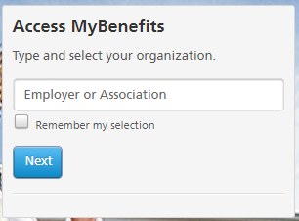
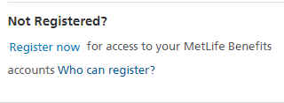
MetLife Member Website
Instructions and information for Members to access the MetLife Member Website
We Encourage all Employees Enrolled in an NDPHIT MetLife Product to Register Online.
NDPHIT and MetLife are pleased to provide the MyBenefits website to you.
MyBenefits provides a secure, easy-to-use site for you to access your MetLife group benefit information online. The website will provide you with additional plan information, provider searches and more that can assist you in understanding your benefits and knowing where to go for assistance when needed.
1) Go to http://metlife.com/mybenefits
2) On the right you will see Type and select your organization
3) Enter: NDPHIT
4) You will be taken to the NDPHIT MetLife benefits page
5) On the right you will see “Not Registered? Register now”
6) Complete your registration information to validate your identity and move through the system to create your login accordingly

Slide 2
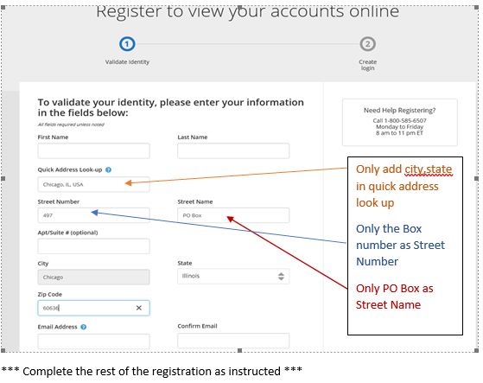
Important Notes When Registering:
If you use a PO BOX as your primary address in the BSwift enrollment platform, there is a needed work around or you may experience trouble. The work around is shown in the box to the right.
If you have any problems with the registration process contact the MetLife registration team at
800-585-6507 for assistance.
Other important information:
Group Name is NDPHIT or North Dakota Public Health Insurance Trust
Group Number for all MetLife Products (except Legal plan) is: 228847
MetLife Customer Service Advocate: 800-438-6388
The MyBenefits website is a great resource of information and assistance for your MetLife Products. You will benefit from a personalized home page, a subscriptions page to manage your email preferences for EOB’s and more, click to chat if you need assistance on the site, mobile capabilities, benefit information, provider finder, tools and resources, forms at your fingertips, claim status and much more!
Legal Plan information:
The legal plan does have a separate site. When using the MyBenefits site there is a link that will take you to that separate site. If you wish to go direct the Legal plan site is www.legalplans.com.
Group Number for the Legal Plan is: 9228847
MetLife Legal Plans Customer service: 800-821-6400

